Slide 1

Introduction to JFC/Swing
Alex Chaffee
jGuru Training by
the MageLang Institute
alex@jguru.com
www.jGuru.com

Slide 2
Outline
Introduction
Packages
Components
Events
Model/View/Controller (MVC)
Advanced Component Usage

Slide 3
What is JFC?
JFC → Java Foundation Classes
Five key pieces:
  Java 1.1 Abstract Window Toolkit (AWT)
  Java2D API
  ***Swing***
  Native Drag and Drop
  Accessibility API
Notes:
Swing is just a small part of JFC. While the Swing component set is frequently referred to as JFC, Swing is only a subset of it.

Slide 4
What is Swing?
Abstract Window Toolkit (AWT) V2
100% Pure Java
  Requires JDK 1.1.2 or higher
Part of JFC
  Components
  New high-level components
  Pluggable Look & Feel

Slide 5
AWT Philosophy
Lowest Common Denominator
  If not available natively on one Java platform, not available on any Java platform
Simple Component Set
Components Peer-Based
  Platform controls component appearance
  Inconsistencies in implementations
    Interfacing to native platform error-prone
Notes:
AWT was designed to be something that could easily be ported between multiple Java implementations. It used a Lowest Common Denominator approach, such that if some feature was not available everywhere, it wasn’t made available from Java.
All components rely on the underlying OS to display components. Every Java implementation has its own set of bugs because of this interfacing to the native platform.

Slide 6
What Went Wrong
AWT Not Enough/Sufficient
Everyone Created New Components
  Netscape’s IFC
  Microsoft’s AFC, WFC
  …
Bloated Applet Download Time
  Vendors wanted their component set incorporated into browsers

Slide 7
Swing Philosophy
Richer Component Set
  Replaces AWT Component Set
  Adds more complex components
Swing Components Java-Based
  If problems, same problems everywhere
100% Pure Java
  Java 1.1.2+ Required
  Java 1.1 Event Model Only
Notes:
The Swing component set corrected most of AWTs deficiencies. Since everywhere was written in Java, everything worked the same on all Java platforms. It also introduced many new and interesting components to the developer’s palette.

Slide 8
Swing = Lightweight
All widgets are 100% Pure Java
  No peers
  Use Graphics to draw
“J” versions of all the basic widgets
  JButton, JFrame, JList, etc.

Slide 9
Swing = Consistent
All widgets share common functionality
  Double-buffered
  Tooltips
  Extensible via subclass
  Track the tab key for focus
  Support keyboard shortcuts
  Internationalizable

Slide 10
Swing = Consistent (cont.)
JButtons and JLabels can contain icons
  Built from GIF files
JPanels can have standard borders
JMenus and JMenuBars can be added to any container

Slide 11
Two Flavors of Swing
Included with Java 2 (JDK 1.2) APIs
Usable in Java 1.1 Environments
  javax.swing.*
  Cannot be in java.* hierarchy and be downloadable to JDK 1.1 browsers
Both environments use javax.*
  Allows developers to have same code base for both
Internals are different
Notes:
While the Swing component set ships with Java 1.2 environments, it is not a part of Java 1.1. However, it is downloadable separately and usable in any Java compliant 1.1 environment. While the external APIs may be the same, the internals may be different.
For instance, the 1.2 classes may utilize the Collections API introduced in Java 1.2.

Slide 12
Two Views of Swing
Alternative Java 1.1 AWT components
  1.0 Event model NOT supported
  Some new components, too
Model/View/Controller Interface
  Separate data from how physically shown on screen and interactions
  More up-front work required

Slide 13
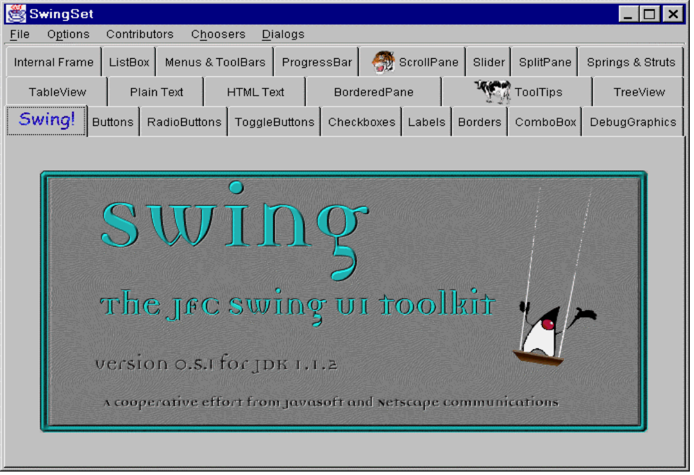
SwingSet
Example program comes with Swing

Slide 14
Transitioning from AWT
For most components, add J before name
  Button → JButton, Applet → JApplet, …
Work from Components out to Containers
  Adding to top-level containers different / delegate
Java 1.1 Event Model Only
Swing containers double-buffered
  Drawing of Swing components (anything) within them won’t flash
Notes:
Transitioning to Swing from AWT (or JBuilder’s JBCL controls) is fairly simple. In AWT’s case, it is mostly just places a J before class names and following a strange behavior that requires you not to add components directly to the internals of the Swing Frame, but by adding them into an internal container of the Jframe.

Slide 15
Swing as an AWT Replacement

Slide 16
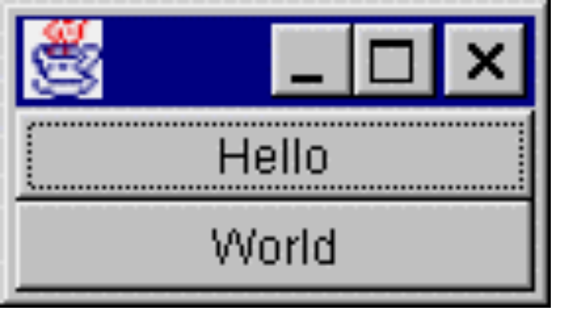
Swing vs. AWT 1.1
class MyActionListener implements ActionListener {
public void actionPerformed (ActionEvent e) {
System.out.println (e.getActionCommand());
}
}
...
ActionListener al = new MyActionListener();
Button b1 = new Button ("Hello");
b1.addActionListener (al);
add (b1, BorderLayout.NORTH);
JButton b2 = new JButton ("World");
b2.addActionListener (al);
add (b2, BorderLayout.SOUTH);

Slide 17
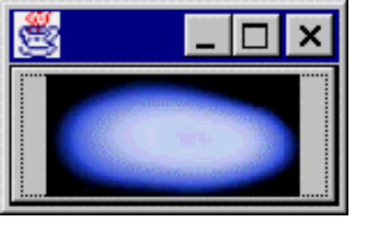
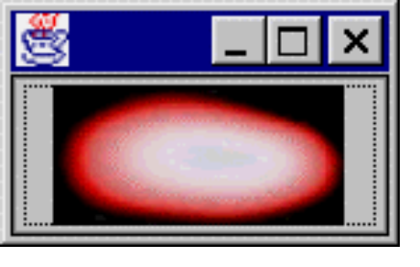
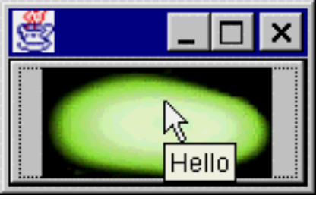
More on Swing’s JButton
import java.awt.*; import com.sun.java.swing.*;
public class MyFrame1 extends Frame {
Icon icon1 = new ImageIcon ("space01.jpg");
Icon icon2 = new ImageIcon ("space02.jpg");
Icon icon3 = new ImageIcon ("space03.jpg");
public MyFrame1() {
JButton b1 = new JButton (icon1);
b1.setPressedIcon (icon2);
b1.setRolloverIcon (icon3);
b1.setRolloverEnabled (true);
b1.setToolTipText ("Hello");
add (b1, BorderLayout.NORTH);
}
public static void main (String args[]) {
Frame f = new MyFrame1();
f.pack(); f.show();
}
}

Slide 18
JButton Enhancements
Image support
  Actually “Icon” support
  MediaTracker not required (w/ ImageIcon)
  Serializable
Separate Icons for different states
  Normal / Disabled / Disabled-Selected / Pressed / Rollover / Selected
ToolTip text
Keyboard accelerators for label

Slide 19
Swing Component Overview

Slide 20
Swing Component Hierarchy
Container
  JComponent
    AbstractButton
      JButton
      JMenuItem
        JCheckBoxMenuItem
        JMenu
        JRadioButtonMenuItem
      JToggleButton
        JCheckBox
        JRadioButton

Slide 21
Swing Component Hierarchy/2
JComponent
  JComboBox
  JLabel
  JList
  JMenuBar
  JPanel
  JPopupMenu
  JScrollBar
  JScrollPane

Slide 22
Swing Component Hierarchy/3
JComponent
  JTextComponent
    JTextArea
    JTextField
      JPasswordField
    JTextPane
      JHTMLPane

Slide 23
More Components
FontChooser
JColorChooser
JDesktopIcon
JDirectoryPane
  JFileChooser
JImagePreviewer
JInternalFrame
JLayeredPane
  JDesktopPane
JOptionPane
JProgressBar
JRootPane
JSeparator
JSlider
JSplitPane
JTabbedPane
JTable
JToolBar
JToolTip
JTree
JViewport

Slide 24
Icons
A fixed-size image or glyph
Can be used with almost all components (e.g. JButton)
Icon is an interface that any class can implement
Icon used over Image because Image is asynchronously loaded and not serializable

Slide 25
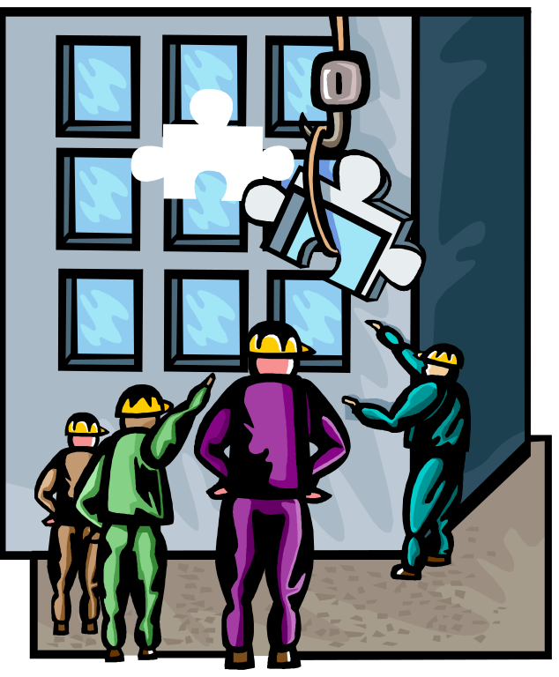
Swing Component Overview

Slide 26

Top Level Components
All subclass Window, not JComponent
Not lightweight, have peer
Components added to content pane
  RootPaneContainer interface - container delegate
Notes:
The top-level components within Swing are not peer-less, like the JComponent children. They require a heavy-duty component to subclass.

Slide 27
Using RootPaneContainer
No longer add components directly to top level containers
  aFrame.add (new Button (“Help”));
Add to “content pane”
  aJFrame.getContentPane().add (…);
  Layout manager too - default BorderLayout
JDialog, JFrame, JWindow, JApplet, JInternalFrame
Notes:
When adding components to a top level component, you use the getContentPane method, and it to what that returns. This method comes from the RootPaneContainer interface.

Slide 28
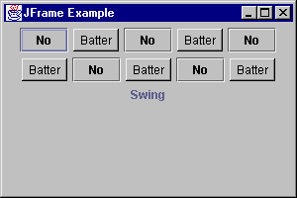
JFrame Example
public class FrameTester {
public static void main (String args[]) {
JFrame f = new JFrame ("JFrame Example");
Container c = f.getContentPane();
c.setLayout (new FlowLayout());
for (int i = 0; i < 5; i++) {
c.add (new JButton ("No"));
c.add (new Button ("Batter"));
}
c.add (new JLabel ("Swing"));
f.setSize (300, 200);
f.show();
}
}
Notes:
Working with AWT and Swing components can be no different.

Slide 29
JFrame Closing Behaviors
When user selects window manager Close option for JFrame, has default behavior
  Frame did nothing
  JFrame hides itself
setDefaultCloseOperation (operation)
  DO_NOTHING_ON_CLOSE
  HIDE_ON_CLOSE
  DISPOSE_ON_CLOSE
  No EXIT_ON_CLOSE operation
Notes:
The JFrame class acts a little differently than the standard Frame. It is no longer necessary to remember to associate a WindowListener to the frames.

Slide 30
JApplet
If using Swing components in an applet, subclass JApplet, not Applet
  JApplet is a subclass of Applet
  Sets up special internal component event handling, among other things
  Can have a JMenuBar
  Default LayoutManager is BorderLayout
Notes:
All Swing applets must subclass JApplet, not Applet. JApplet is a subclass of Applet, but it is necessary to perform some extra internals work before the component can do its thing.
A JApplet can also have a menu bar, which wasn’t previously mentioned.
And, if you were accustomed to your applet’s having the default FlowLayout, it is now based on BorderLayout

Slide 31
JOptionPane
Standard dialog boxes
  Yes, No, Cancel - or custom prompts
  Message
  Input
  Anything goes (you can specify everything)
  All dialogs are modal - blocks current thread
  String response =
  JOptionPane.showInputDialog(this, "Enter input:");

Slide 32
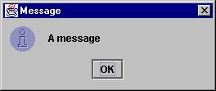
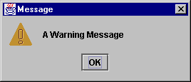
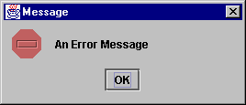
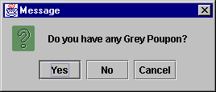
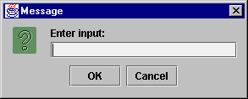
JOptionPane Examples

Slide 33
AWT Replacements
JLabel - like Label
  Still single line of text
  Also supports Icon, Border,
  Position text/icon in 9 areas, vs. 3 alignments
  Also position text/icon relative to each other
JButton - like Button
  Still single line of text
  Also supports Icon, positioning, ...
Notes:
Transitioning from AWT to Swing requires you to know what’s the same and different with the old environment.
JLabel and JButton are basically the same as before, supporting a single line of text. However, they offer many additional capabilities that were not previously available.

Slide 34
AWT Replacements/2
JPanel - like Panel
  Double-buffered (no JCanvas)
JCheckBox - like Checkbox
  JRadioButton for mutual exclusion group
    Grouped with ButtonGroup, not CheckboxGroup
JToggleButton - no AWT equivalent
  Provides a “stay pressed” state
  Great for tool bars
Notes:
The JPanel acts similarly to the Canvas object. There is no JCanvas object any more.
The JCheckBox doesn’t act like the prior beast (Checkbox). There are now two separate components for a single check box and a group of them.
The JToggleButton offers a third alternative, that has no AWT equivalent.

Slide 35
AWT Replacements/3
JComboBox - like Choice
  Editable - setEditable(boolean)
  Auto-initialize from array
    JComboBox jc = new JComboBox (aStringArray);
JList - like List
  Auto-initialize from array
  Scrolling not directly supported
    Must put in JScrollPane
Notes:
The JComboBox offers a Choice component with an editable option.
The JList control requires you to add it a JScrollPane to support scrolling.
Both JList and JComboBox allow you to initialize the controls with an array of objects (most likely text strings).

Slide 36
AWT Replacements/4
JScrollPane - like ScrollPane
  Scrolling component set in constructor or
  Container delegate
    Added to viewport / getViewPort().add()
  Can place objects in inner four corners, column headers or row headers
    Tables automatically use column header area

Slide 37
AWT Text Replacements
JTextField - like TextField
  Supports text justification
  JPasswordField for passwords
    Cannot clear/unset echo character
JTextArea - like TextArea
JTextPane - styled text support
JEditorPane - lightweight HTML/RTF editor/viewer
Notes:
The tree of text components within Java has changed a little. There are now special classes for inputting password and entering multi-styled text, as well as a simple HTML viewer.

Slide 38
ScrollBar Replacements
JScrollBar - like Scrollbar
JSlider - Scrollbar for picking values
  Display major / minor ticks
  Associate labels with ticks
Notes:
The JScrollBar is a run-of-the-mill replacement for ScrollBar. Of more interest is the JSlider which offers labeled values and tick marks, among other features.

Slide 39
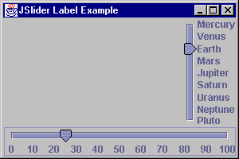
JSlider Example
JSlider right, bottom;
right = new JSlider(JSlider.VERTICAL, 1, 9, 3);
Hashtable h = new Hashtable();
h.put (new Integer (1), new JLabel("Mercury"));
h.put (new Integer (2), new JLabel("Venus"));
...
h.put (new Integer (9), new JLabel("Pluto"));
right.setLabelTable (h);
right.setPaintLabels (true);
right.setInverted (true);
bottom = new JSlider(JSlider.HORIZONTAL, 0, 100, 25);
bottom.setMajorTickSpacing (10);
bottom.setPaintLabels (true);

Slide 40
Menu Replacements
In JComponent class hierarchy
  JMenuBar - MenuBar (JFrame.setJMenuBar)
  JMenu - Menu
  JMenuItem - MenuItem
  JCheckBoxMenuItem - CheckboxMenuItem
  JRadioButtonMenuItem - no AWT
    Group with ButtonGroup
JSeparator - menu separator
  added by addSeparator
Notes:
Working with menus in Swing is a little different. No longer are the menu components in a separate class hierarchy. All components now subclass JComponent, the root of the Swing component set.

Slide 41
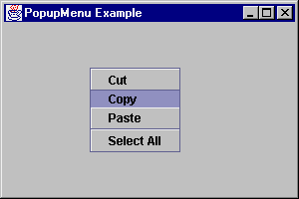
PopupMenu Replacement
JPopupMenu - like PopupMenu
  Added addSeparator method

Slide 42
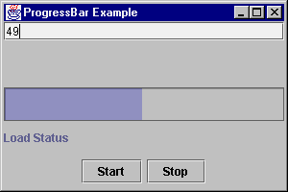
Progress Bar
Displays progress of operation
  Can be used like a gauge
Usage:
  Initialize
    JProgressBar progressBar = new JProgressBar();
    progressBar.setMinimum(0);
    progressBar.setMaximum(numberSubOperations);
  Go
    progressBar.setValue(progressBar.getMinimum());
    for (int i = 0; i < numberSubOperations; i++) {
    progressBar.setValue(i);
    performSubOperation(i);
    }
Notes:
The JProgressBar component is an interesting control that allows you to monitor the progress of some measured usage.

Slide 43
Tool tips
Context-sensitive text string that pops up when mouse rests over a particular object
JToolTip class supports this
  Rarely used
  Use setToolTipText method of JComponent
Singleton ToolTipManager manages tool tip operations

Slide 44
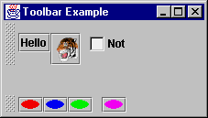
Tool bars
Display components in
single row/column
Can float or dock
Can contain any component
  Best if all the same, or similar type
  Consider using JToggleButton
Has addSeparator method
Notes:
JToolBar works with Actions, which will be described shortly.

Slide 45
Tabbed Pane
Tabbed panel control
Similar to using CardLayout with buttons for selecting cards
Use addTab to add components/panels

Slide 46
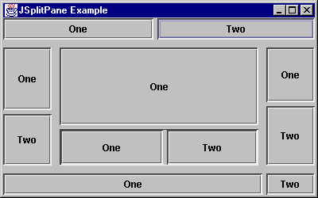
Split pane
Allows user-controlled resizing of two components
Can move divider programmatically with setDividierLocation
  int parameter
    absolute position
  float parameter
    percentage

Slide 47
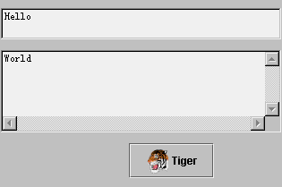
Box
Basically, a JPanel with a default layout manager of BoxLayout
  You specify direction
Offers non-visual components for spacing/stretching
  Glue and Struts

Slide 48
BoxLayout
Arranges components along either x or y axis in the order added
Unlike AWT layout managers, components’ positions and sizes may be specified separately
Along non-primary axis, makes all components as tall/wide as tallest/widest component

Slide 49
Box
Basically, a JPanel with a default layout manager of BoxLayout
  You specify direction
Offers Glue and Struts for spacing

Slide 50
ScrollPaneLayout
Used by JScrollPane
Not created directly

Slide 51
ViewportLayout
Used by JViewport
Not used directly

Slide 52
Advanced Swing

Slide 53

Swing Event Handling

Slide 54
Swing Events

Slide 55
Event Support
Listener classes in support of each event
Each event has source(s) within Swing
Class EventListenerList available to maintain list of all listeners
  Responsibility of class maintaining list to provide type safety, and routine to notify all listeners
Inherit Component/Container 1.1 events

Slide 56
Event Actions
Sort of a button and a toolbar icon and an Action Event Listener rolled into one
Action interface extends ActionListener
  For when multiple controls need same behavior
  AbstractAction class Action implementation
    Manages list of controls listening to action
  Adding Actions supported by JMenu, JPopupMenu, and JToolBar
Notes:
Swing includes a special ActionListener called Action for defining the handling of action events. AbstractAction is a concrete implementation of the Action interface.
They are directly supported by JMenu, JPopupMenu, and JToolBar to add components to these containers

Slide 57
Actions
You can add an Action to a toolbar
The toolbar makes a button for it and asks the Action what icon to use
Helps separate behavior from UI
  Easier to script or change program logic

Slide 58
Actions Implemented
Define Action
    class CutAction extends AbstractAction {
    public CutAction () {
    super (“Cut”, new ImageIcon(“Scissors.gif”);
    }
    public void actionPerformed (ActionEvent e) {
    System.out.println ("Selected: " + getValue (Action.NAME));
    }
    }
Add to multiple places (Action a = new MyAction(...);)
  aJMenu.add (a) / aJToolBar.add (a) / …
Disable a, disables menu, toolbar, ...
Notes:
Once you’ve defined an action, you can add it directly to the control.
Then, if you wish to disable the selection of controls associated with the action, maybe because the action isn’t appropriate for the current state of the system, you do NOT disable each component associated to the Action. Instead, you disable the Action and it notifying everyone associated to it.

Slide 59
Text Actions
TextAction extends AbstractAction
Ask text component how to handle operation
  Action actions[] = aJTextComp.getActions();
Find Action to perform operation
  Search through array
Associate Action to component
  addActionListener(...)
Notes:
Text actions are special actions for handling text-handling events. With text actions, you ask a text component how it handles an event. This returns the text action, which you associate with ActionListener handlers.

Slide 60
Text Actions
Get Action List
  Hashtable commands = new Hashtable();
  Action[] actions = jt.getActions();
  for (int i = 0; i < actions.length; i++) {
  Action a = actions[i];
  commands.put(a.getValue(Action.NAME), a);
  }
Find action / associate to component
  JButton cut = new JButton("Cut");
  Action cutIt = (Action)commands.get (DefaultEditorKit.cutAction);
  cut.addActionListener (cutIt);

Slide 61
Key Strokes
KeyStroke represents a keystroke
  KeyStroke stroke = KeyStroke.getKeyStroke (KeyEvent.VK_J, ActionEvent.ALT_MASK, true); // ALT-J
Associate to JComponent
  jb.registerKeyboardAction (new MyActionListener(), stroke, JComponent.WHEN_FOCUSED);
When keystroke happens within component, action happens
  Conditions: WHEN_FOCUSED, WHEN_IN_FOCUSED_WINDOW, WHEN_ANCESTOR_OF_FOCUSED_COMPONENT
Notes:
Keystrokes are for key events. Instead of manually monitoring keyboard input for specific characters, then responding to them when selected, you associate ActionListeners to components and tell them what key sequence acts as a trigger.

Slide 62

Model/View/Controller Architecture

Slide 63
Model/View/Controller
Model - Defines state of system
  Underlying logical representation
View - Defines how user sees model
  Visual representation of data in model
Controller - Defines how user interacts with model
  User interaction handler
Model changes → Views notified

Slide 64
Model/View/Controller/2
Separation of Model and View
  Multiple views of the same model
  Model not affected when view changed
View uses Controller to specify response mechanism
MVC is not only for GUI components

Slide 65
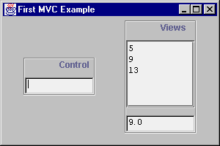
Why MVC?
Notes:
This diagram depicts how MVC is useful.
Imagine the control on the left accepting input, where the view on the top right displays a list of values entered and the bottom right displays the average of everything entered so far.
How do you support this with just handling events the 1.1 way? If you associate both items on the right to the action listener of the control, you don’t know what order the two views will be notified in. If the averager is notified first, it will calculate the average of old values.
You could also associate only the top view with the control, then have the averager register itself with the top view, such that it will always get the proper list of elements to average. However, if you desire to drop the list of entries, you run into trouble because, while it was acting as a view of the controller, it was serving as a controller for the averager.
This brings us to the MVC approach which says to not keep the data separate from the view.

Slide 66
Swing and MVC
Swing uses MVC variation
  View/Controller combined into delegate
  View/Controller communication typically complex; delegate simplifies
Example: Checkbox
  Has state true/false in Model
  Screen corresponds to Delegate-View
  Mouse clicks are handled by Delegate-Controller, sending input to Model
Notes:
Swing combines the VC part of MVC into a UI delegate.
This delegate is responsible for converting user input into model updates and vice versa.

Slide 67
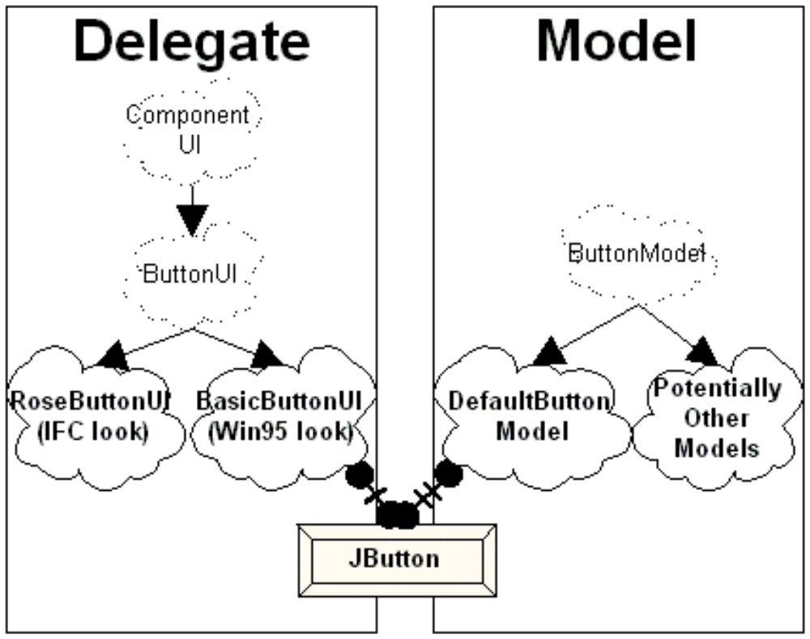
Delegate / Model View

Slide 68
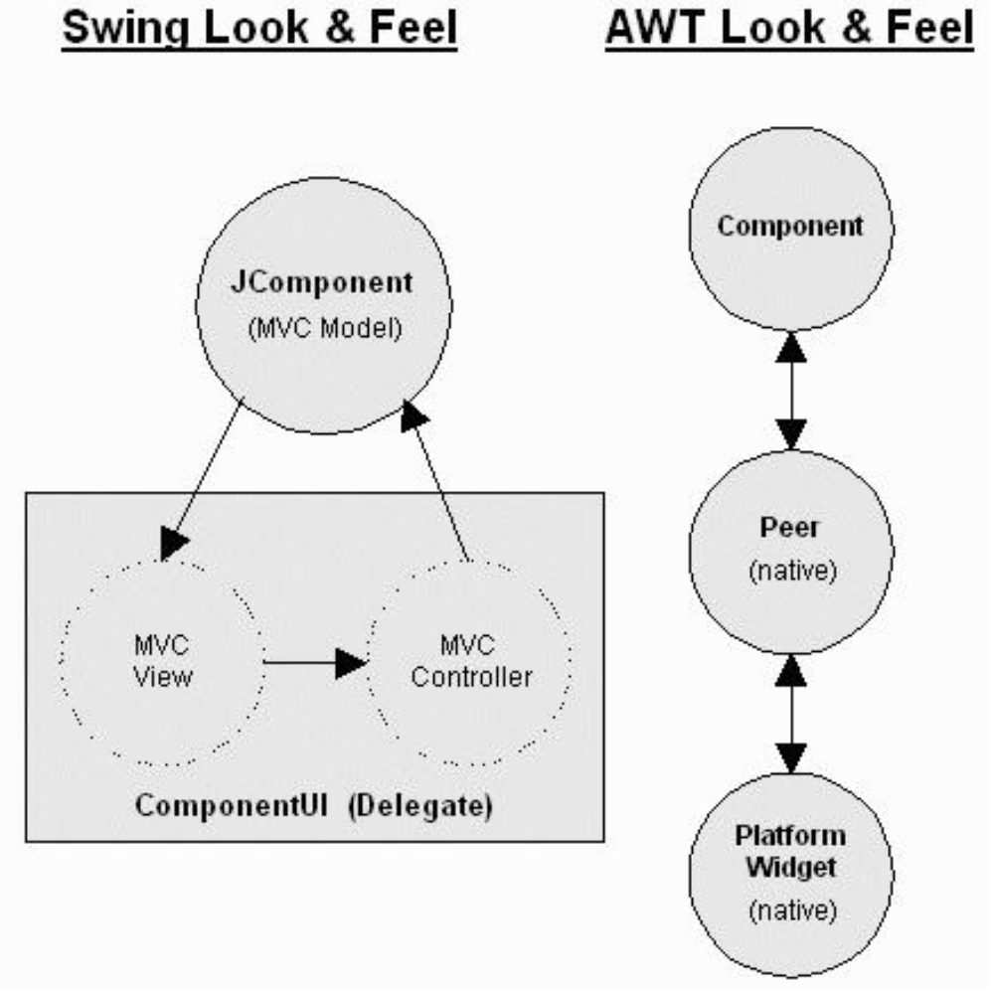
Swing vs. AWT

Slide 69
JTree
Data Model - TreeModel
  default: DefaultTreeModel
  getChild, getChildCount, getIndexOfChild, getRoot, isLeaf
Selection Model - TreeSelectionModel
View - TreeCellRenderer
  getTreeCellRendererComponent
Node - DefaultMutableTreeNode

Slide 70
More on JList
No longer just text
Can display Icon
Can change display line when selected
Data Model - ListModel
  default: DefaultListModel
  getSize / getElementAt (position)
View - ListCellRenderer
  getListCellRendererComponent()

Slide 71
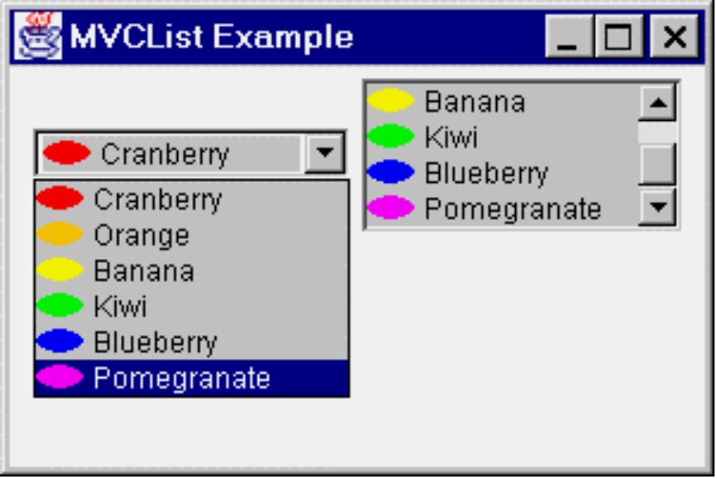
JComboBox
Data Model - ComboBoxModel
  Extends ListModel
  get/set SelectedItem
Same cell renderer as JList

Slide 72
JTable
Can just create JTable from data[][] and columnName[] and not worry about anything else
Data Model - TableDataModel
  default: DefaultTableModel
  getRowCount, getValueAt, setValueAt, getColumnCount, getColumnName, ...
View - JTable
  Contains JTableColumns

Slide 73
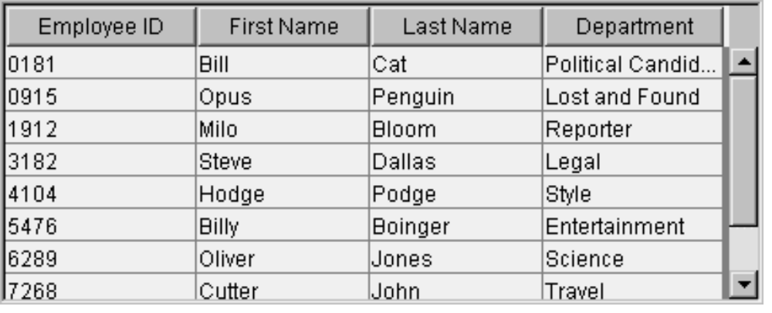
JTable Output

Slide 74
Contact Information
Alex@jguru.com

Slide 75
Credits
Some images provided by Hey You! Productions
http://hey-you.com/graphics/index.html
you@hey-you.com
Thanks to John Zukowski, Randy Kahle from jGuru

